Slide 1


Grant Agency of Charles University (GA CU)
2024
Guideline for recipients

Slide 2
Contents
General part …….…………………..3–5
Financial part ……………………..6–19
REQUISITIONS application……....20
Personal expenses……………..21–25
Subsistence expenses………..26–28
Other non-investment costs 29–31
Book purchases………………...32–33
Publications …..………………...34–36
Material part of the project 37–43

Slide 3
General part
The project’s activities may commence on 1 January 2024.
The project’s expenses are also eligible starting from 1 January 2024 (pay attention to the pre-approval of expenses via the REQUISITIONS application – slide 20).
Drawing down funds:
For ongoing projects, you may start after signing the contract.
For new projects, you must first submit a specimen signature to the Finance Office (FO).
The contract must be signed by 3 May 2024.

Slide 4
General part
Each project is managed under the project billing number, i.e. the accounting order/or centre (number specified in the agreement article I/4) – for drawdowns and settlement, you must closely cooperate with the FO; the billing number is the project identifier for the faculty accounting system.
The principal investigator for the project must be a student of the Faculty of Arts of Charles University (FA CU); if the principal investigator/student co-investigator interrupts or terminates their studies, they may not continue with the project or draw down funds (however, you can request a change, see the Material part of the project, starting from slide 37).
Any interruption/termination of studies must be immediately announced to the Grant Office by e-mail.

Slide 5
General part
In some cases, you may request an interruption of the project.
A GA CU project may be interrupted for the following reasons:
- Maternity and parental leave
- Long-term health reasons
An interruption may be requested for one calendar year; for two-year interruptions, the request must be submitted again after one year. Requests are addressed to the chair of the CU Grant Council, Prof. Vladimír Komárek, through the GA CU Office (please announce the request to the Grant Office in advance).

Slide 6
Financial part
The funds are always allocated to the project for one calendar year.
Funds may be drawn down after submitting the specimen signature (= podpisový vzor) to the FO.
The specimen signature legitimizes the persons specified in it to dispose of the funds allocated to the project.
The persons specified in the specimen signature are authorized to sign the following forms: proposal for awarding a scholarship, billing form, invoice cover sheet, proposal for remunerating the supervisor (note – this does not apply to the signature on agreements, etc. A power of attorney is need for this).
For multiple-year projects, the specimen signature remains the same, and a new specimen is not needed for an additional year.

Slide 7
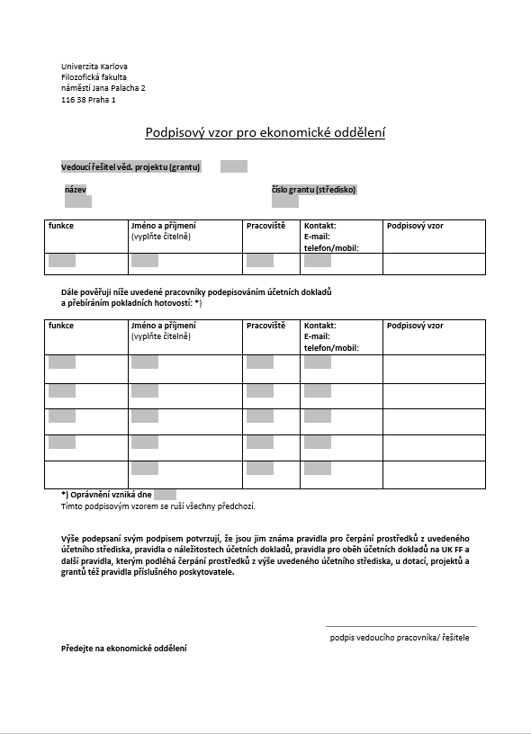

Slide 8
Financial part
The most frequent tax documents are receipts or invoices.
The original accounting documents are submitted to the FO; we recommend keeping a copy of these documents.
Receipts should contain detailed information – itemized.
Invoices must be addressed to Charles University (The faculty does not have legal status and does not issue invoices in its own name*).
The official invoice address is:
Charles University
Faculty of Arts
nám. Jana Palacha 2
116 38 Prague 1
ID no. 00216208, Tax ID no. CZ00216208
*Note – when purchasing air tickets and accommodation, do not address the invoice to the university but to yourself.

Slide 9
Financial part
On invoices, specify the ID number and tax ID number in the correct format. Do not leave out the initial zeros (see previous slide or the web pages of the FO).
The invoice must contain the name of the supplier (again, the correct ID and tax numbers), the address, and the bank account information.
The issue date, the due date, and for VAT payers, the date of taxable supply.
Scope of supply (the unit price, i.e. how the total price was calculated).

Slide 10
Accounting document requirements – most common errors
The entire university has the same identification number and tax identification number.
Some companies leave out the two initial zeros when issuing invoices – This is a mistake!
The number must always have all eight digits.
Correct ID and tax numbers : ID no. 00216208, Tax ID no. CZ00216208
Wrong customer, especially when making purchases online: The customer is a person; but the official invoice address of the Faculty of Arts, Charles University must be stated (see slide 8).
For online sales, you must agree with the seller on the correctly issued invoice.

Slide 11
Accounting document requirements – most common errors
Incorrect name of the university: e.g. “CU”, “CU in Prague”, etc. Documents with incorrect names cannot be accepted or paid by the FO.
Correct name of the university: on all tax documents where the name of the customer is required, the following correct name must always be stated: “Charles University, Faculty of Arts”.
Payments by card may be made only when purchasing air tickets or other expenses paid via the scholarship for subsistence expenses, otherwise it is not allowed. The account statement is required for all expenses paid by card and is submitted to the Grant Office.

Slide 12

Accounting document requirements – Orders exceeding CZK 50,000, exclusive of VAT
All orders exceeding CZK 50,000, exclusive of VAT must be published by the faculty in the register of contracts of the Czech Ministry of the Interior.
Such orders must always be made only by written agreement and their conclusion is subject to Notification of the Secretary 4/2016.
No employee or student of the FA CU is authorized to conclude on behalf of the faculty any contract exceeding CZK 50,000, exclusive of VAT.
In the event of uncertainties regarding the procedure for orders over CZK 50,000 (exclusive of VAT), please contact the secretary of your department.
http://www.ff.cuni.cz/wp-content/uploads/2013/01/16-11-07.pdf

Slide 13
Forms for billing at the Faculty of Arts
Invoice cover sheet – Use this with an invoice that is correctly issued to the FA CU. First, provide the invoice to the secretary of your department, who will enter the invoice in the Electronic Filing Service (ESS). Then take the invoice with the invoice cover sheet to the mail room for scanning and handing over to the FO.
Billing form – Based on this form, the billed amount will be paid out to you (that which you have already paid); provide this to the FO together with the original invoices, either in person or via the mail room.
Fill in: name, order (= billing number), contact, unit-department, subject matter, amount, date, signature according to the specimen signature.
The forms are available here: https://www.ff.cuni.cz/fakulta/struktura-historie/oddeleni-dekanatu/ekonomicke-oddeleni/formulare/.
The FO’s deadline for accepting accounting documents will most likely be set for 30 November 2024 (the term will be specified by a dean’s measure).

Slide 14
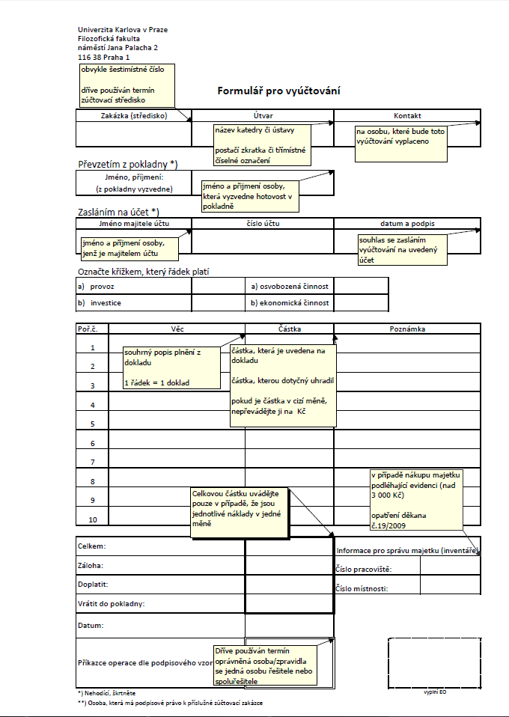

Slide 15
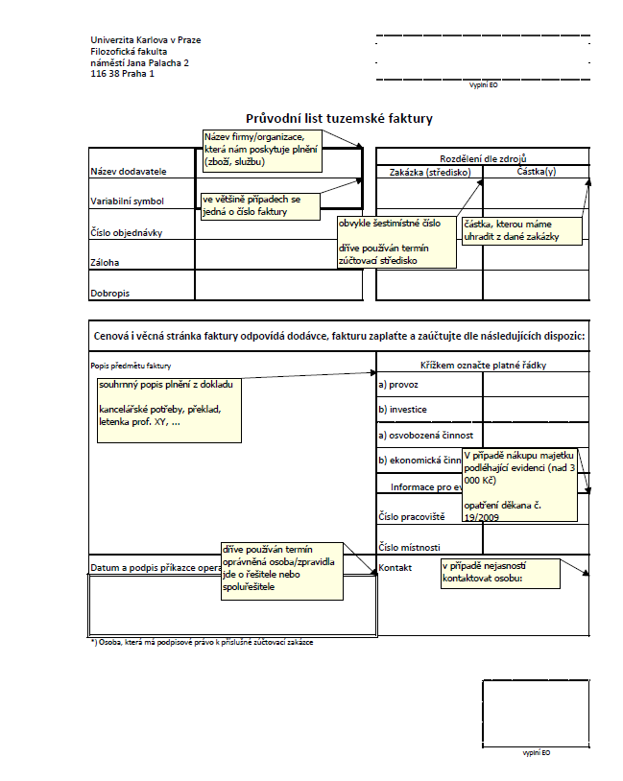

Slide 16
Financial part – Changes to the project’s budget
Transferring funds between the individual entries is possible. Any change to a specific entry newly must not exceed CZK 20,000. However, it does not apply to transfers to personal expenses - here the original limit of CZK 10,000 remains.
Complying with the limits in the entries when planning transfers (For the limits, see the GA CU procurement documents – http://www.cuni.cz/UK-2446.html).
Any changes exceeding CZK 20,000 or 10,000 in case of personal expenses require the approval of the GA CU – A request may be submitted by approximately the end of October 2024.

Slide 17
Financial part – Changes to the project’s budget
The request is sent to the GA CU to the attention of the chair of the Grant Council of Charles University, Prof. Komárek, in the form of a personally signed letter, either in writing or electronically (scanned)
GA CU
Ovocný trh 560/5
116 36 Prague 1
or to the address: gauk@ruk.cuni.cz
The request must contain the contact address for sending the written response. It must be addressed to the chair of the Grant Office and contain the reason for the change (why the change occurred) and the purpose of the change (the new use), as well as the new structure of the budget and information stating which Charles University faculty the investigator studies at.
The request should also contain the grant project number as specified in the application, and not the billing numbers of the faculty or contract numbers.
Please consult any changes and requests with GO in advance.

Slide 18
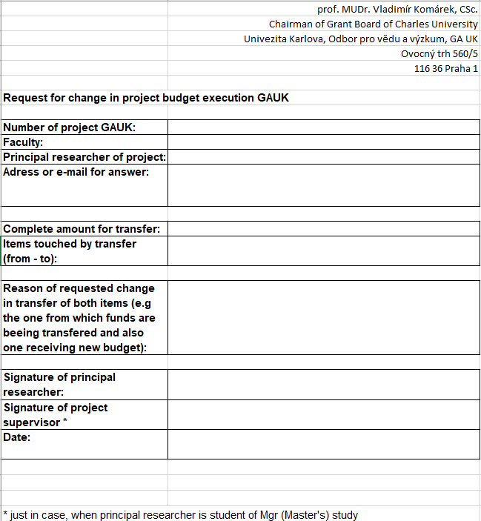

Slide 19
Financial part – drawdowns and returns
We recommend that you draw down the funds on a regular basis thus avoiding any returns due to non-use.
If you discover during the year that you will not draw down all of the funds in the grant, please inform the Grant Office immediately.
Do not resolve undrawn funds at the last minute. We always try to avoid any return of funds.

Slide 20
REQUISITIONS application (ŽÁDANKY)
Before purchasing any goods or services (except for expenses paid in the form of a scholarship – travel, air tickets, accommodation, conference fees, …), the expenses must be approved via the REQUISITIONS application.
After entering the data in the application and the subsequent approval by the Faculty of Arts, you may purchase the approved item.
Application: https://cis.ff.cuni.cz/fcgi/verso.fpl/_TS_/1613482004?fname=web_index&__def_stranka__=zad_zadanka_sez&__def_filtr__=1&fname=web_index&_navig_code_=3cacd3a30704dd161f2e8e95df74936c&__modul_name=Objedn%C3%A1vky%20/%20%C5%BD%C3%A1danky
Manual: http://manualy.ff.cuni.cz/index.php/%C5%BD%C3%A1danky
If you need assistance, use the following e-mail address: zadanky@ff.cuni.cz

Slide 21
Personal expenses – scholarships for students
Proposals for scholarships are submitted to the Grant Office by 30 June 2024 (other proposals arising from the transfer of funds may be submitted by agreement).
You can download the form here: https://www.ff.cuni.cz/fakulta/struktura-historie/oddeleni-dekanatu/projektove-grantove-oddeleni/formulare/ (proposal according to Article 6).
Before submitting the proposal, check whether you have right account number in SIS, because it is important for generating the decision on awarding a scholarship.
After the Grant Office processes your proposal, you will be notified by SIS about Decision on Awarding the Scholarship. Please waive the right to appeal (open Decision – Personal data – Documents + Updating page – Waiving rights to appeal). After you waive the right to appeal, the decision will come into force and your scholarship will be paid out within 30 days.

Slide 22
Personal expenses – scholarships
A scholarship may not be paid out to:
- a student who has interrupted or terminated their studies
- a student in a bachelor’s programme of study (they may be a member of the research team with no entitlement to remuneration in the form of a scholarship)
Scholarships of co-investigators – always use separate proposals.
If a co-investigator is from another CU faculty, you must conclude an agreement on the transfer of funds – please consult with the Grant Office.

Slide 23
Personal expenses – Wages for employees
If head of project or supervisor is an employee of the Faculty of Arts, the project investigator submits a “Proposal for the payment of remuneration to an internal employee”.
The form for the proposal for the payment of remuneration to an internal employee is available here and will be sent by the Grant Office at the end of June with detailed instructions for completion.
Payment of remuneration will be possible approximately from 1 July 2024 to 25 September 2024 (Agreements on the Performance of Work and Agreements on Work Activities can also be arranged now).
The amount you have in the budget for remuneration is gross wage including contributions to insurance of 34.8%; you should differentiate in the form between gross wages and insurance; the total amount must be equal to what you have in the budget; remuneration is paid for a period of six months.
Submit the proposal completed according to the instructions of the Grant Office to Human Resources (https://www.ff.cuni.cz/fakulta/struktura-historie/oddeleni-dekanatu/osobni-oddeleni/).

Slide 24
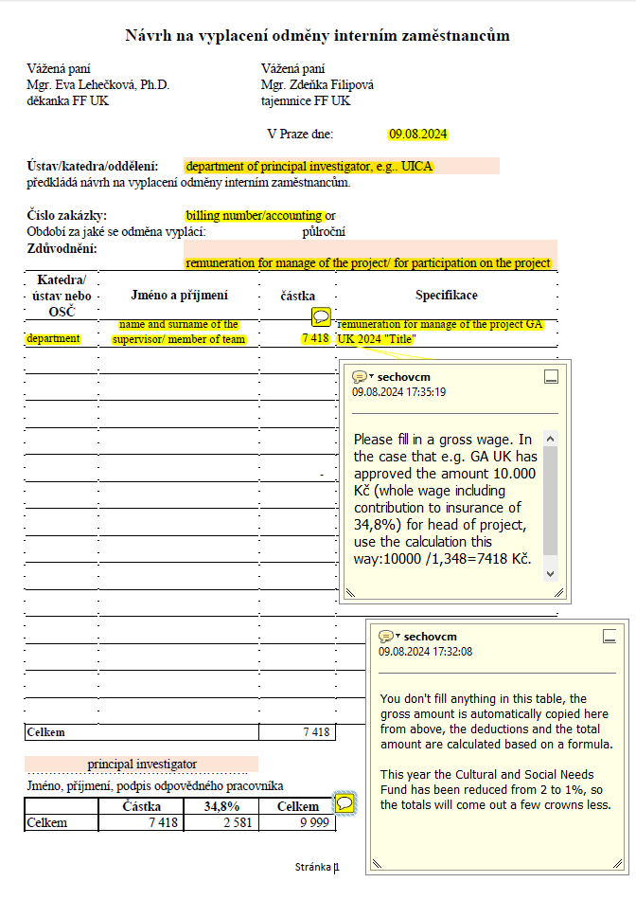
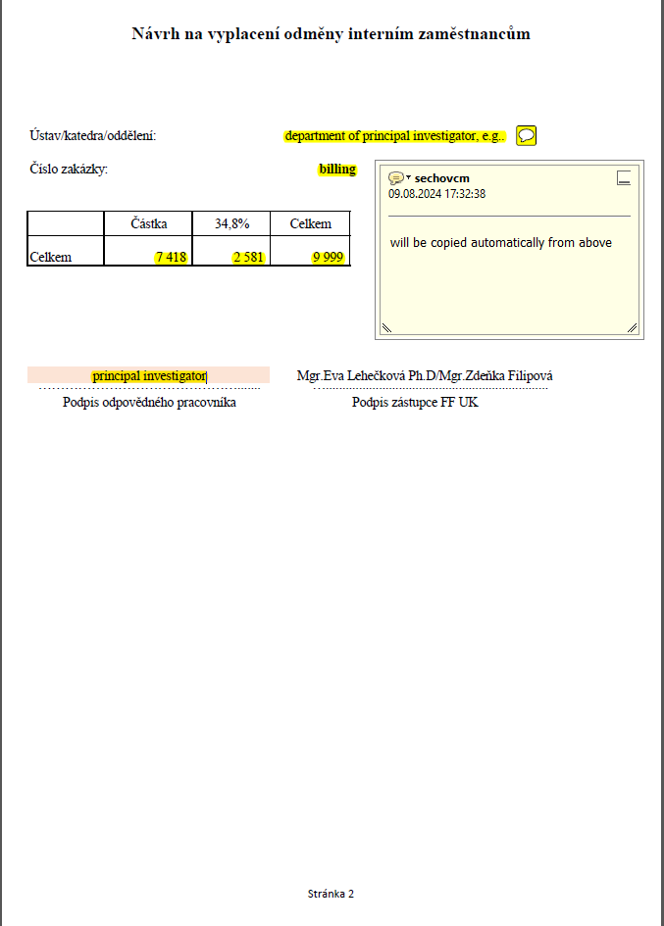

Slide 25
Personal expenses – agreement for external workers
If head of the project/supervisor/other member of the research team is not an employee of the Faculty of Arts, the project investigator pays him/her using “Agreement on the Performance of Work” or an “Agreement on Work Activities” .
He fills out form for agreement in cooperation with the secretary of his own basic unit (institute or department).
Payment of agreements will be possible from approximately 1 April 2024 to 25 September 2024. The amount will be paid out after the submission of the time sheet to the Human Resources.
The 34.8% insurance may also be deducted from the amount you have budgeted for the agreement if the limits are exceeded or if the agreements are overlapping; always consult possible deductions with the secretary of your basic unit; the agreement is usually paid for a one-month period.
For completing the administrative work please cooperate with Human Resources. (www.ff.cuni.cz/odd-oso).

Slide 26
Subsistence expenses – students
Plan your travel sufficiently in advance.
Subsistence expenses are paid retroactively in the form of a scholarship (an untitled agreement is concluded only with a co-investigator studying at another CU faculty).
Advances are not provided.
Eligible costs: fares (international and local – even in the Czech Republic/economy class), public transport fares, accommodation (max. 3* hotel/guest house), travel insurance, conference fees, as well as fees for libraries, etc.
Ineligible expenses: food, pocket money, expenses connected with the use of a car, tuition.
After taking a trip, the student submits to the Grant Office a proposal for awarding a scholarship (travel) and the completed attachment to the proposal. The forms are available at the following address: https://www.ff.cuni.cz/fakulta/struktura-historie/oddeleni-dekanatu/projektove-grantove-oddeleni/formulare/
The attachment should contain the length of the trip, the destination, the purpose of the trip in several sentences, a list of accounting documents demonstrating that the trip was taken and the duration, and the originals of all documents. The scholarship is paid out based on these documents. Save all receipts that you want to have reimbursed.
Documents (tickets, air tickets with boarding passes, account statements if payments were made by card, etc.) are submitted together with the completed attachment and the scholarship proposal to the Grant Office.
Try to follow the budget from the application. Any changes should be consulted with the GO.

Slide 28
Subsistence expenses– employees
Only if subsistence expenses have also been approved in a request for people other than the student research team.
Employees of the FA CU travel based on travel orders.
If investigators are employees of the faculty under an Employment Contract
  With the consent of the head of the department, as with every business trip, they submit a travel order and related documents
  If investigators are employees of the faculty under an agreement
  Work arranged under an Agreement on the Performance of Work or an Agreement on Work Activities must concern activities relating to the project, and travel expenses must be contractually arranged in the agreement.
Trips are settled only based on valid tickets (in the case of students, also based on other accounting documents).
If a student takes a trip in their own vehicle or a rented vehicle, petrol and vehicle depreciation are not reimbursed.
GA CU 2024

Slide 29
Other non-investment expenses (material and services)
Eligible expenses: Office supplies and paper, small tangible assets, computer equipment, (only in justifiable cases), services (e.g. editing, translations), literature, publication costs (including open access), remuneration for respondents (agreement on reimbursement).
Ineligible expenses: computer programs that the faculty can provide, phone costs, creation of web pages, preparation of concerts/exhibitions/conferences/symposia, tuition.
All purchases in this category must be recorded and approved in advance in the REQUISITIONS application. Registration via the VERSO system at cis.ff.cuni.cz. (for more information, see slide 20)
The purchase of computer equipment is handled centrally by IT Services; in Requisitions/Žádanky application (section of IT Services/ LVT – výpočetní technika).
The purchase of books is handled centrally by the Centre for Academic Information (SVI) at the Faculty of Arts Library (in Requisitions/Žádanky app, section Centre for Academic Information (SVI) – books from grants / SVI – knihy z grantů).
GA CU 2024

Slide 30
Other non-investment expenses (material and services)
You may purchase office supplies and small tangible assets individually. After approval of the purchase in Requisitions, you can draw down the funds based on submission of the relevant accounting document (receipts to the FO, invoices to the mail room).
You submit the accounting documents together with the invoice cover sheet or the billing form – fill in the number of the accounting order (billing number) that has been assigned to you (see contract).
The cover sheet/form must be signed by the principal investigator of the project according to the specimen signature.
Also provide the following: workplace (department/institute) and contact, text – purpose of payment.
http://www.ff.cuni.cz/fakulta/oddeleni-dekanatu/ekonomicke- oddeleni/formulare/ (form to be downloaded)
If you purchase office paper, please agree with your department after approval of your request (The FA CU has a contract with a specific supplier; you may not purchase it anywhere else).
GA CU 2024

Slide 31
Other non-investment expenses (material and services)
Software is acquired in the business or educational version; the licence is always for the university, never for a person.
The invoice cover sheet should always contain the correct workplace (department), room number (the office of the responsible person), and the responsible person (employee of the department – supervisor, secretary); the other parts are processed by the FO.
Purchased items are the property of the faculty; after the grant has ended, they remain at the investigator’s department.
All orders and contracts exceeding CZK 50,000, exclusive of VAT must be concluded in writing (see Notification of the Faculty Bursar 4/2016); contact the secretary of your department.

Slide 32
Book purchases
The acquisition of books, journals, and electronic sources of information is handled by the Centre for Academic Information (SVI) at the Faculty of Arts Library (main building, basement S124).
This process is regulated by the methodological material How does the purchase of books at the Faculty of Arts work? available at: https://ffuk.sharepoint.com/:b:/s/Knihovna/Ef3YaHRHXfdNsCzrD9WtcqMBOBhQg7XdwOscXHHFeQIL0Q .
The process is carried out in five steps:
1) The investigator (“financial approver”) creates a request in the Requisitions/Žádanky application (section Centre for Academic Information (SVI) – Books from grants/Journals/Databases / SVI – Knihy z grantů/ Časopisy/ Databáze), provides the budget number (billing number of the project), and saves and sends the request for approval.
2) The request is processed by the acquisitions employee (librarian, “preparer”).
3) Approval of the request – upon request, it is approved by the investigator and the FO employee (“budget administrator”)
4) Order and library processing (recording/assigning a reference number, cataloging)
5) The invoice is paid and the books delivered.
Books may be ordered via the Centre for Academic Information (SVI) until 29 October. Requests should be made sufficiently in advance; delivery could take several months.

Slide 33
Book purchases
In order to pay the invoice, the investigator must sign the invoice cover sheet containing the reference number for the purchased book. The cover sheet is prepared by the acquisitions employee, who then submits the relevant documents to the FO.
Should you have any questions relating to the purchasing process, please contact the preparer for books from grants (Robin Kislinger at robin.kislinger@ff.cuni.cz), use the general address akvizice@ff.cuni.cz., or call us at 221 619 240.
Purchases cannot be made on your own.
Literature available at the FA CU cannot be purchased from grants.
The book will be available to the student in the specialized library as a grant loan (i.e. loaned out for the duration of the project).
When books are purchased from abroad, you must take into account the higher postal costs, customs, and taxes – we recommend verifying everything in advance. For purchasing foreign literature, you may consult the respective librarian or Mr Stein from the FO.

Slide 34
Publications
If the output of the project is a publication, it is deemed a “university work”, as it was created during your studies.
The project investigator cannot freely dispose of the rights to this work (the faculty administers the rights).
The work can be provided to the publisher only under a licensing agreement.
The licensing agreement is concluded between the project investigator (author) and the school (FACU). The FA CU can then conclude an agreement with the publisher.
The Grant Office provides the template licensing agreement based on the clear specifications of the work (number of authors and their relationship to the faculty (student/employee/external person), type of work – monograph, collective monograph, proceedings; provision of licence for the entire work/a part of the work)
The project investigator (author) agrees with the publisher on the details: scope of the work, number of copies, publication date, costs, etc.
The data for the project investigator is added to the licensing agreement in cooperation with the Grant Office and Legal Services.
After the licensing agreement is signed by the project investigator (author) and the FA CU, three copies of the agreement are sent to the Legal Services, which arranges for the signature of the FA CU bursar.
After the licensing agreement is signed by the FA CU and the publisher, four copies of the agreement are sent to the Legal Services, which arranges for the signature of the FA CU bursar.

Slide 35
Publications
Based on the agreement, the publisher may issue an invoice to the faculty after handing over the manuscript for the work.
If the invoice exceeds CZK 50,000, exclusive of VAT, the invoice may not be issued until the agreement is published in the register of the Czech Ministry of the Interior; the investigator receives information on publishing the agreement by e-mail (see Notification of the Bursar http://www.ff.cuni.cz/wp-content/uploads/2013/01/16-11-07.pdf).
The publisher provides the invoice to the investigator (author), and the investigator arranges to have it entered in the ESS, submitted together with the copies of the agreement and the invoice cover sheet to the mail room (in order to meet the due dates, we recommend this method instead of sending it by post).
Three copies of the publication must be provided to the Centre for Academic Information (SVI) and two copies to the Grant Office (required under the agreement)
The rules for issuing publications do not apply to an article in a journal.

Slide 36
Publications – acknowledgements and affiliations
All publications (monographs, articles, conference proceedings, etc.) must contain acknowledgements and affiliations, otherwise they will not be recognized, and the project will be assessed as unfulfilled.
Note that they are two different types of information!
They are presented in the language of the results.
Acknowledgements:
Acknowledgements can be for several GA CU projects.
You can thank the GA CU and other providers together.
The same output cannot be used as the unique publication output for two or more GA CU projects.
Recommended wording: “This work/research was made possible with the financial support of the Charles University Grant Agency, project no. ..., entitled “...”, implemented at the Faculty of Arts of Charles University.”
Affiliations:
State the author of the text anywhere in the text (the project investigator at the FA CU)
Official wording: “Charles University, Faculty of Arts”.

Slide 37
Material part of the project
Planning: We recommend organizing the various parts of the project (especially trips, publications) sufficiently in advance.
Sufficient planning in advance prevents any complications, the results of which could have a negative impact on the objectives of your project.
In the event of uncertainties, please contact the Grant Office during business hours or by e-mail or telephone – see http://www.ff.cuni.cz/fakulta/oddeleni-dekanatu/grantove-oddeleni/.

Slide 38
Material part of the project – Changes to the project
Change in the principal investigator or supervisor – Send a request to the GA CU (for contacts, see https://www.cuni.cz/UK-1673.html).
Change in co-investigators – A request is not necessary, but you must announce this to the Grant Office.
Ongoing projects: Make changes in the application (this can be done from April to the beginning of October) by providing the name of the new person + providing reasons for the change in the interim and final reports.
Last year: Changes cannot be made in the application; provide reasons in the final report.
If changes are made to the research team, you need to comply with the rule stating that the sum of the funds for scholarships is more than 75% of the total funds earmarked for wages and scholarships and also the rule stating that the number of students is at least equal to the number of other research team members (see the GA CU rules http://www.cuni.cz/UK-2446.html)
If a co-investigator is a student of a bachelor’s programme of study, they become a member of the project team with no entitlement to a scholarship.

Slide 39
Material part of the project – Changes to the project
What should a request for changes contain?
Any request intended for the GA CU must always be sent in the form of a personally signed letter, either in writing or electronically (scanned). It must always contain the contact address for the response and be addressed to the chair of the Grant Council, Prof. Komárek. It must also contain the reasons and purpose of the request and which CU faculty the investigator studies at.
For a new supervisor, the same as in the case of a new principal investigator, the personal ID number must be stated in the request.
A request for a change in the supervisor must also contain the consent of the current (original) and the newly proposed head of the project.
The request should contain the grant project number as stipulated in the application, not the faculty billing numbers or the agreement numbers.
You should always consult the Grant Office before sending the request.

Slide 40
Material part of the project – Interim and final reports
Interim Report (IR):
Relates to ongoing projects.
Submitted via the GA CU application.
Submission deadline at the beginning of January of the following year, always published in the application; the investigators will also be informed by e-mail.
Consists of the Annual Report and the Request for Continuation of the Project; for more information, see the completion manual in the application.
The IR includes a request for funds for another year.
The amount of the requested funds must correspond to the funding outlook (maximum increase of 10%)

Slide 41
Material part of the project – Interim and final reports
Final Report (FR):
Submitted after the end of the project together with the completed outcomes, approximately in the middle of March of the year following the end of the project.
If outcomes have not been completed, you may request in the FR a postponement of the evaluation (at least a manuscript should be attached). Subsequently, the request is assessed by the GA CU Council, and if successful, the evaluation is postponed by one year; All funds must be settled by the end of November of the implementation year for the project.
If the evaluation is postponed, the FR is submitted the next year with a brief description and documented outputs.

Slide 42
Material part of the project – Interim and final reports
Final Report (FR):
IMPORTANT: Article 4, paragraph 7 of the GA CU agreement:
The principal investigator is required to submit the final report. If this is not done, then the supervisor of the project has this obligation. If this is not done by the investigator or the supervisor, the faculty must return the additional expenses for the last year of the project.
If the investigator does not fulfil this obligation, the faculty will request payment of the additional expenses from the department of the investigator.
If a project has received evaluation "not fulfilled" or "fulfilled with reservation", it is possible to submit relevant publication outputs and request the Grant Council to change the evaluation by the end of the following year in which the final report was evaluated.

Slide 43
Material part of the project – Interim and final reports
It is important to meet the deadlines for submitting the reports. This is connected to other required administrative matters relating to the continuation or evaluation of the project.
In the part relating to settlement of the project, list the drawn-down entries. These amounts must correspond with the accounting system (the accounting order of your project) –> cooperation with the FO and requesting the creation of the accounting order from Mr Stein (FO) are required.
Write a detailed commentary on the drawdown of funds (stating “funds were drawn down as planned” is not sufficient)
Justify any changes (material, personnel, etc.)
Describe and justify any transfers of funds.
If the allocated funds were not drawn down completely, the funds must be returned to the GA CU, including the proportional part of the overhead (If possible, try to avoid any return of funds, and always consult this situation immediately with the Grant Office)
Any return of funds must be justified in a commentary, and the specific amount must be stated.

Slide 44

Thank you for your attention!
Mgr. Monika Sechovcová
Mgr. Jiří Tříska
Grant Office
https://www.ff.cuni.cz/fakulta/struktura-historie/oddeleni-dekanatu/projektove-grantove-oddeleni/

