Slide 1
Who Speaks Latin? From Medieval to Modern Philosophy
28.4.2022
Anna Tropia, Ph.D.
Ústav Filosofie a Religionisticky

Slide 2
The project:
Who spoke Latin in the Middle Ages?
When, more precisely?
What had all this to do with philosophy?

Slide 3
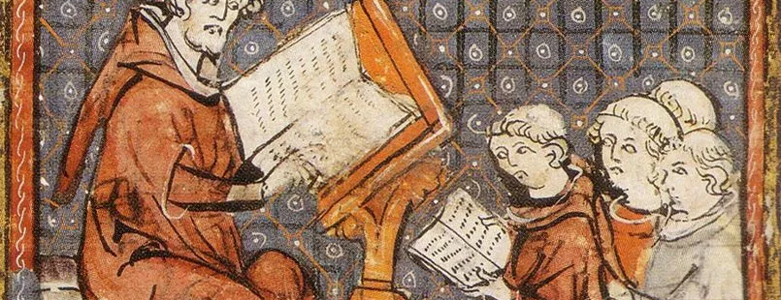
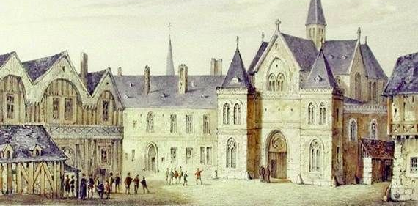
I. Who spoke Latin in the Middle Ages?
Officers and functionaries
Clerics and professors
Students!

Slide 4
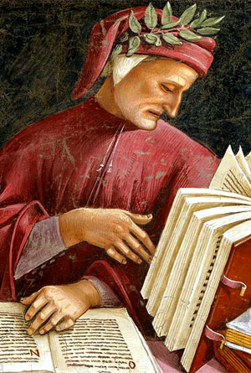
…and who did not?
I say that it may clearly be seen that Latin would have conferred its benefits on few while the vernacular will be of service to many. For goodness of mind, which this service attends to, is found in those who because of the world’s wicked neglect of good have left literature to those who have changed it from a lady into a whore; and these noble persons comprise princes, barons, knights, and many other noble people, not only men but women, of which there are many in this language who know only the vernacular and are not learned. […] And so it is evident that complete generosity moved me to employ the vernacular rather than Latin. [Convivio, I. IX. 4-5]

Slide 5
II. When, more exactly?
Scholars have advocated many different termini for our period, and there seems to be little agreement and indeed little basis for reasoned argument on these points. The Middle Ages begin, we are told, with the death of Theodosius in 395, or with the settlement of Germanic tribes in the Roman Empire, or with the sack of Rome in 410, or with the fall of the Western Roman Empire (usually dated C.E. 476), or even as late as the Moslem occupation of the Mediterranean. It ends … with the fall of Constantinople, or with the invention of printing, or with the discovery of America, or with the beginning of the Italian wars (1494), or with the Lutheran Reformation (1517), or with the election of Charles V (1519). Several reference works I have consulted simply assert that the Middle Ages ended in 1500, presumably on New Year's Eve. Yet another terminus often given for the Middle Ages is the so-called “Revival of Learning,” that marvellous era when Humanist scholars “discovered” classical texts and restored them to mankind after the long Gothic night. […] In view of all this disagreement over the duration of the Middle Ages, perhaps we should content ourselves with saying that our period extends from the close of the classical period to the beginning of the Renaissance. [F. Robinson, ‘Medieval: the Middle Ages’, Speculum 59 (1984), p. 748].

Slide 6
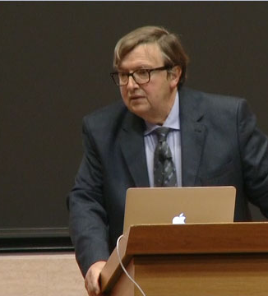
What is the philosophical Middle-Age? How can you conceive – as far as its philosophy is concerned – the unity of a period of about ten centuries? When does it start? When does it end? If all periodization is relative to an object, and if philosophy is taught as long as it is alive, one will answer, by looking at the school institution, that the philosophical Middle Ages began in the 6th century with the closing of the Neoplatonic school of Athens and ends, at the very end of the 15th century, with the creation in Padua of a chair for teaching Aristotle in Greek (i.e. 1497). To write the history of medieval philosophy is therefore to write the history of the philosophical texts of Antiquity, of their forms and genres, of their survival, of their diffusion, of their transmission, of their reproduction, of their reading. [Alain de Libera, inaugural lecture at the College de France, 2014; video, in French, at http://www.college-defrance.fr/site/alain-de-libera/inaugural-lecture-2014-02-13-18h00.htm )

Slide 7
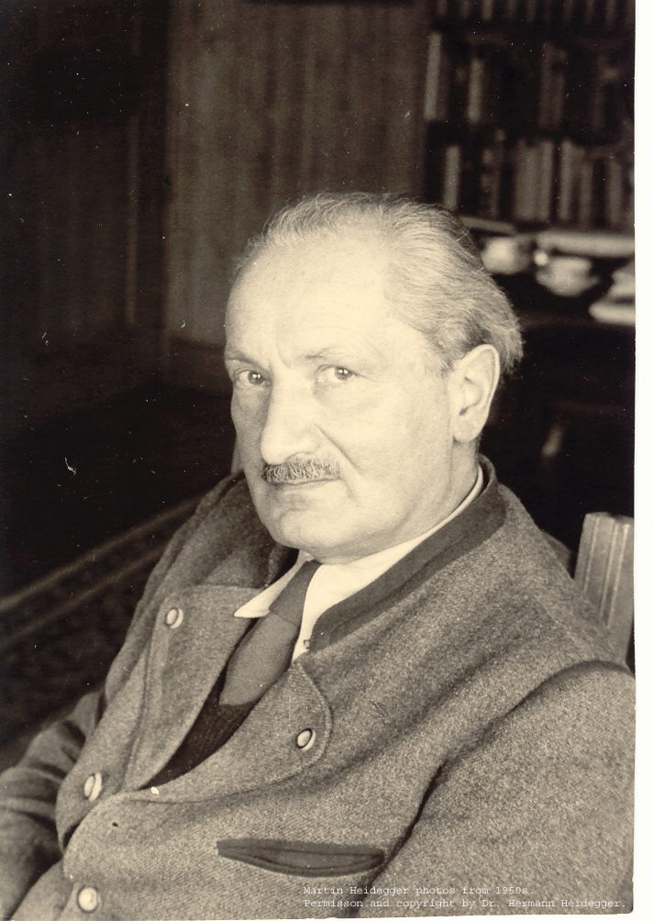
…what if Middle Ages ended a bit later?
For example, according to these criteria:
Use of Latin language
Discussion of topics and texts inherited from Antiquity, always debated, going from the representation of the world to the daily life wisdom and practices
Tensions between faith and reason entering such discussions
Circulation of texts (scientific works, notes, letters) through manuscripts (rukopisy), not only through books
“…Descartes (1595-1650) is the last of the medieval philosophers”
Martin Heidegger

Slide 8
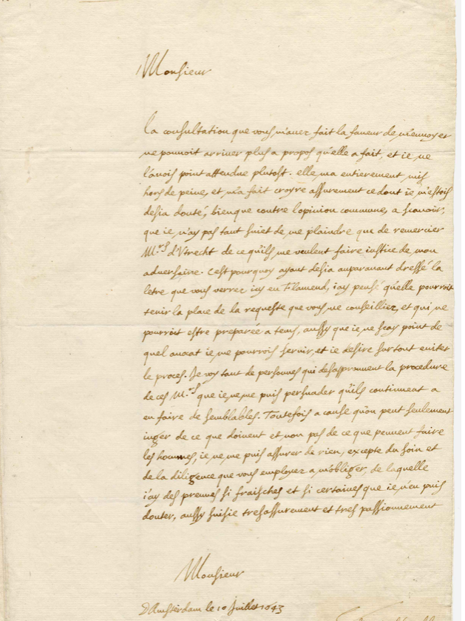
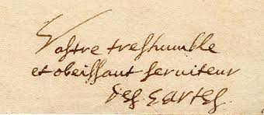

Slide 9
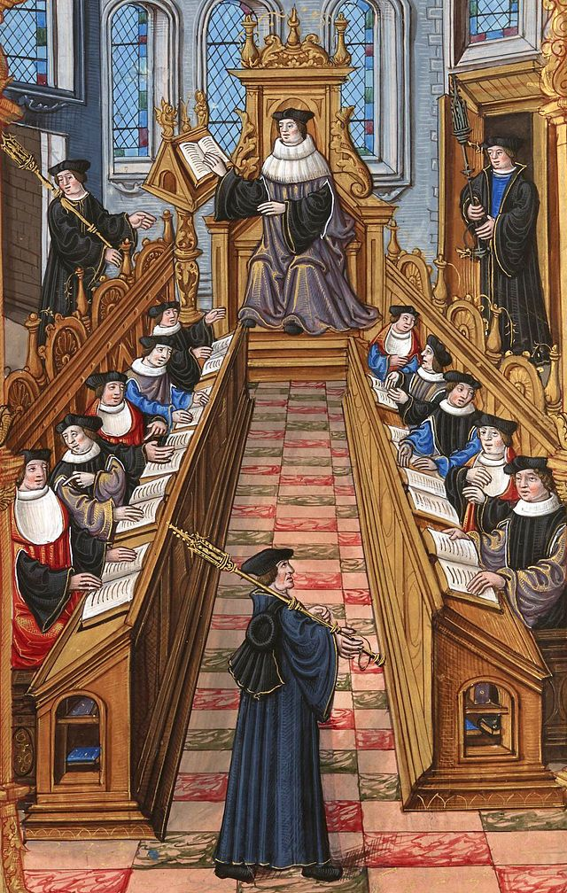
III. What all this has to do with philosophy?
Organization of the studies
General formation (start: 14 years old):
About 6-7 years at the
Faculty of Arts: Grammar, logic, quadrivium, natural philosophy, metaphysics ___________________________________________
Faculty of Theology: 12/16 years studying Bible, Sentences, Historia scholastica (but also some philosophy!)
Faculty of Law: 7/10 years, civil and canonical law
Faculty of Medicine: 7/10 years studying Greek and Arabic medicine (in Latin!)

Slide 10
III. What all this has to do with philosophy?
Organization of the studies
General formation (start: 14 years old):
About 6-7 years at the
Faculty of Arts: Grammar, logic, quadrivium, natural philosophy, metaphysics ___________________________________________
Faculty of Theology: 12/16 years studying Bible, Sentences, Historia scholastica (but also some philosophy!)
Faculty of Law: 7/10 years, civil and canonical law
Faculty of Medicine: 7/10 years studying Greek and Arabic medicine (in Latin!)

Slide 11
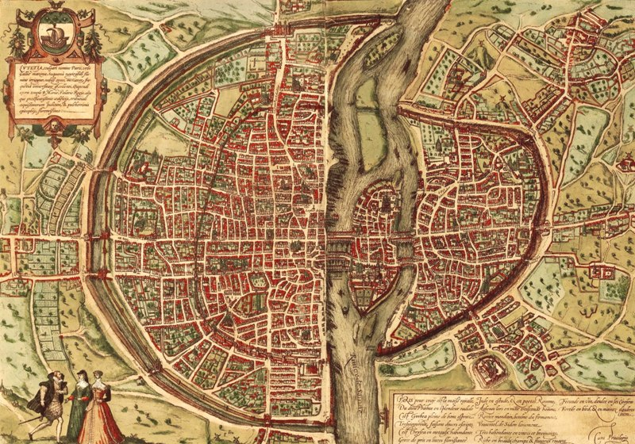
Students spoke Latin!
Students taking notes from the teacher dictating at the university
The “Latin Quarter” in Paris, socalled because there lived Latin speakers: teachers and students

Slide 12
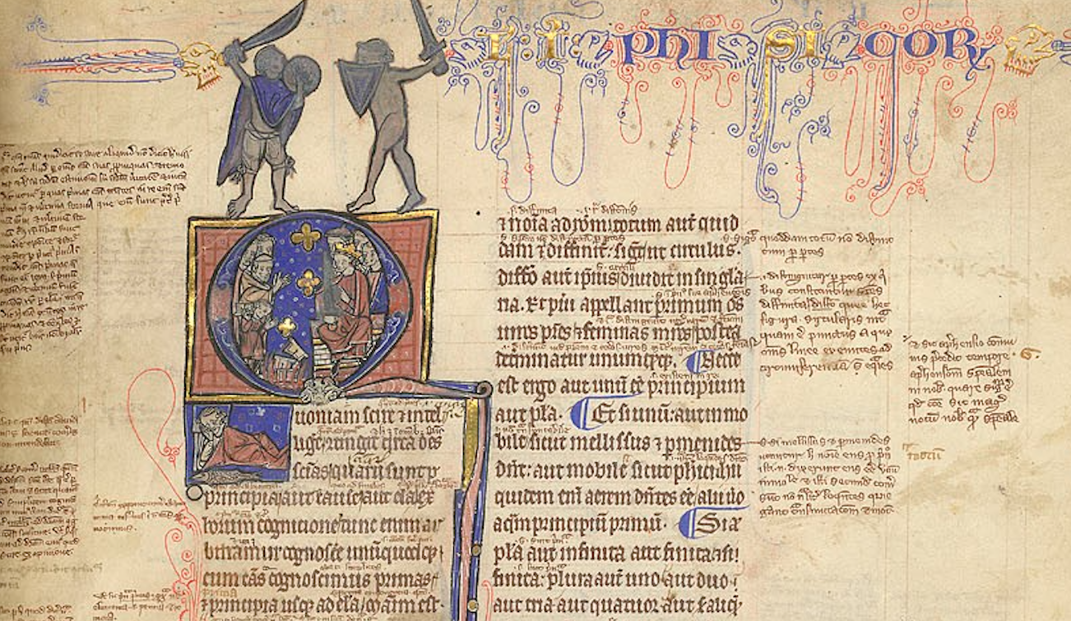
The role of the students in culture transmission
They assured for centuries the survival of texts that tell us about what culture was in their day
How?
Through copies of texts that were material objects
Each with its story, each diverse from the other, but vehiculating (more or less) the same text
They also exerted some influence upon the style of printed books
London, British Library, Harley 3487 (13th century)

Slide 13
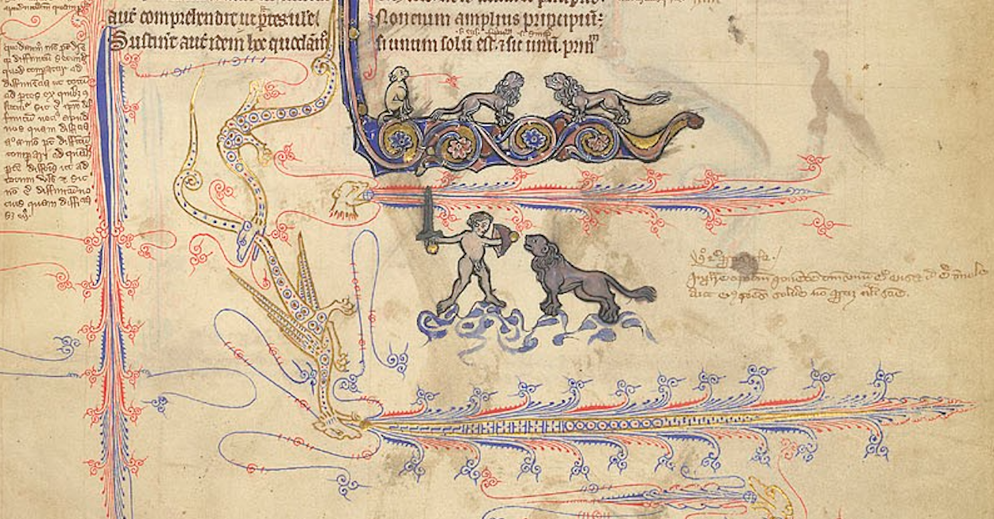
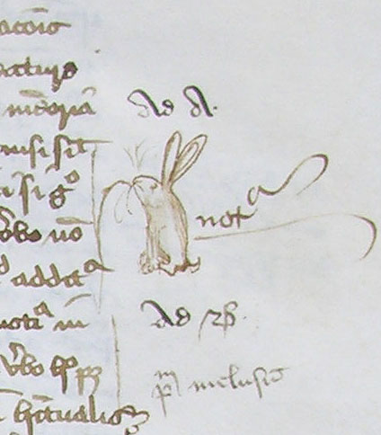
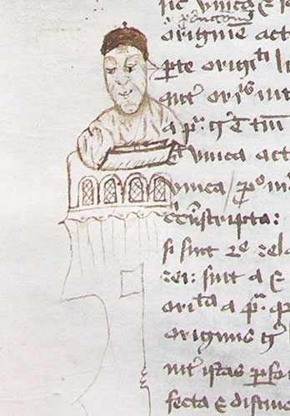
(1) they invented the first comics!
Or they were artists? They made fun of their teachers, too. Marginalia from the manuscript Cambridge F12 (14th century) containing John Duns Scotus’ Quaestiones Quodlibetales

Slide 14
(2) They gave their own contribution!
In the diffusion of neologysms:
The case of “haecceitas” , this-ness
The Scottish philosopher John Duns Scotus (1266-1308) used it only once in his Questions on Metaphysics (Book VII, q. 13)
He wanted to express the uniqueness of each individual and made up this term
His students repeated it in all their works
So that today, the doctrine of individuation of Scotus is indissolubly linked to the concept of “haecceitas”
Illuminated initial of John Duns Scotus’ Questions of Metaphysics (14th century)

Slide 15
Duns Scotus is regarded as one of the first representatives of late scholastics in which philosophy and theology gradually separated. He gave a decisive impetus to this. Because of his relatively early death, Scotus did not leave behind an ordered work, but a multitude of manuscripts for lectures, questions and disputations, of which only an incomplete text (the Ordinatio) was prepared for publication. The found writings were smoothed – following contemporary methods – by inserting supplementary notes or by omitting inconsistencies, not, as would be usual today, published text-critically with all marginal notes, deletions and brackets. In addition, student transcripts were used as a source for improvements and additions

Slide 16
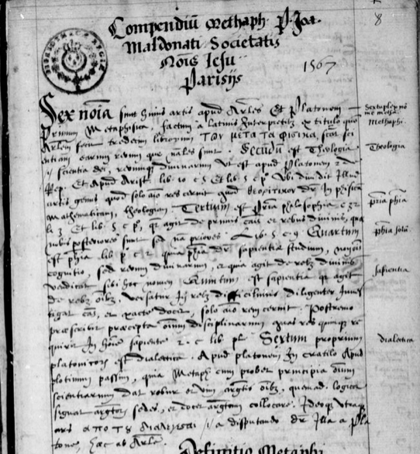
They wrote “books” (3)
They took notes from courses that, most of the time, were not meant for publication
Their notes circulated through Europe and, after the discovery of America, in the new world as well
Students’ courses-notes were responsible for the transmission of ideas and doctrines of their teachers
Nowadays they testify of a submerged world of unpublished texts of their time
Paris, BNF, 6454A (16th century)

Slide 17
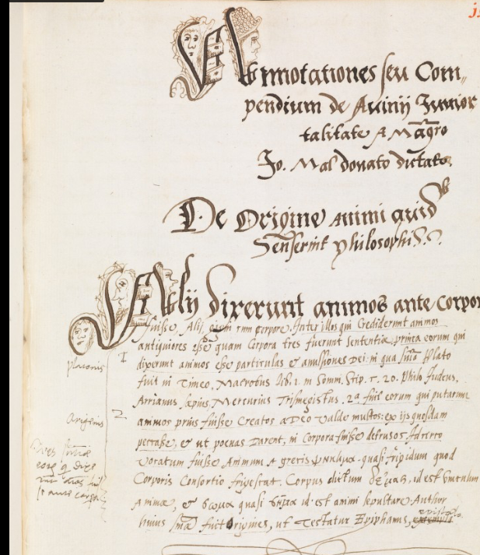
How it looked like

Slide 18
“Liber tertius Aristotelis de anima annotationibus doctissimus D. Jacobi Valentini in Claromontano collegio ordinarii professoris illustratus et elucidatus”

Slide 19
